Slide 1
AI5112023: Machine Learning
Decision Trees, Random Forests and Boosting
Abhinav Mahajan,
IMT2020553
Date: - 15th October

Slide 2
DECISION TREES (Quick Recap)
A binary tree that splits the dataset until we are left with just 1 leaf node.
2 kinds of nodes – Decision/internal nodes and the leaf nodes.
We might not have 100% pure leaf nodes.
In that case we perform majority voting and assign the majority class to the test point.
At each level, impurity of states decreases.
Greedy Algorithm
Current best split that maximizes information gain.
Does not backtrack and change the previous split.
Subsequent splits depend on present split.
Does not guarantee most optimal set of splits.

Slide 3
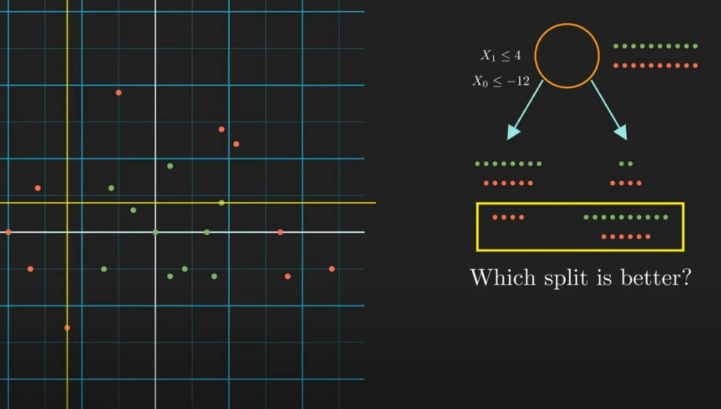
TRAINING A DECISION TREE
At the root, we have the entire dataset.
How to choose the better split?
Model will chose the split that will maximize the information gain.

Slide 4
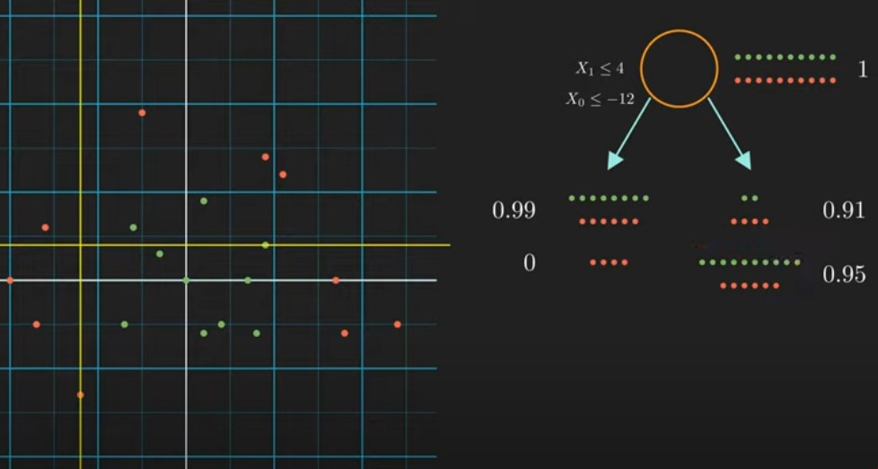
INFORMATION IN A STATE
Entropy = -Σpi log(pi)
Entropy is directly proportional to uncertainty about the class to which the point belongs.

Slide 5
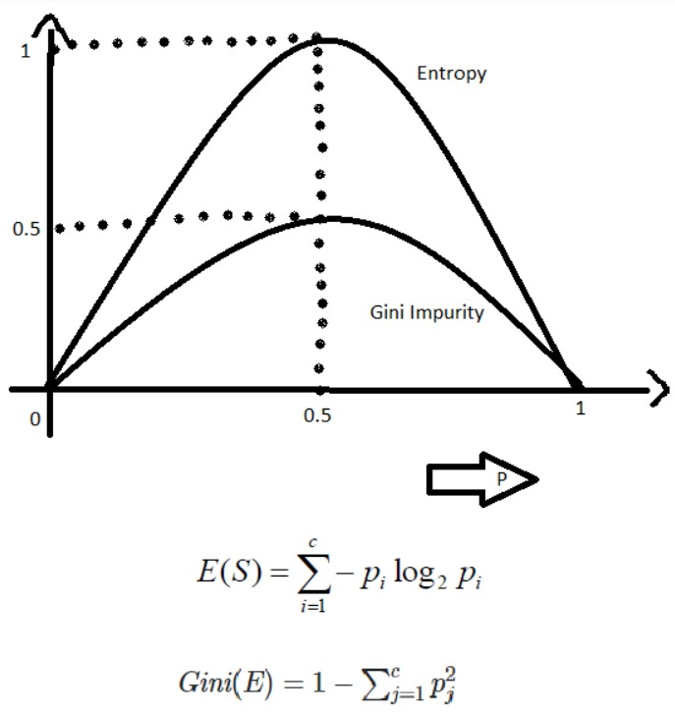
GINI-INDEX vs ENTROPY
Gini Impurity is more efficient than entropy in terms of computing power.
Log is an expensive operation in mathematics.
Deals with real numbers in a shorter range => [0, 0.5]

Slide 6
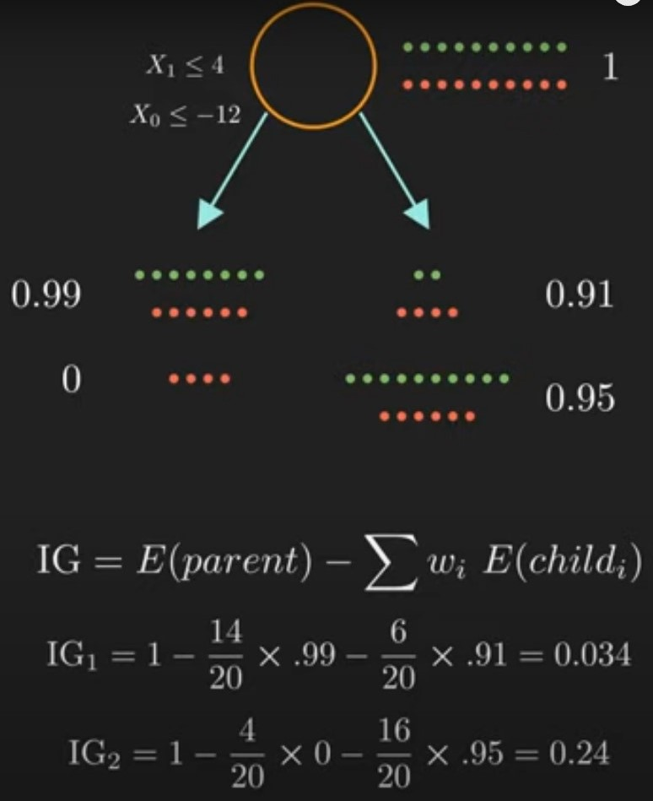
INFORMATION GAIN
Model considers every possible split and takes the one with the maximum information gain.
Traverses through every possible feature and feature value to search for the best feature and the corresponding threshold value.

Slide 7
Decision Tree Ensembling techniques: -

Slide 8
RANDOM FOREST
Collection of many decision trees.
Random Sampling with replacement => Bootstrapped Dataset
This enables our model to be less sensitive to our training data.
NOT all features used for training decision trees.
Pick a subset of features for all trees and use them for training.
Called random because we have used 2 random processes – Bootstrapping and random feature selection.

Slide 9
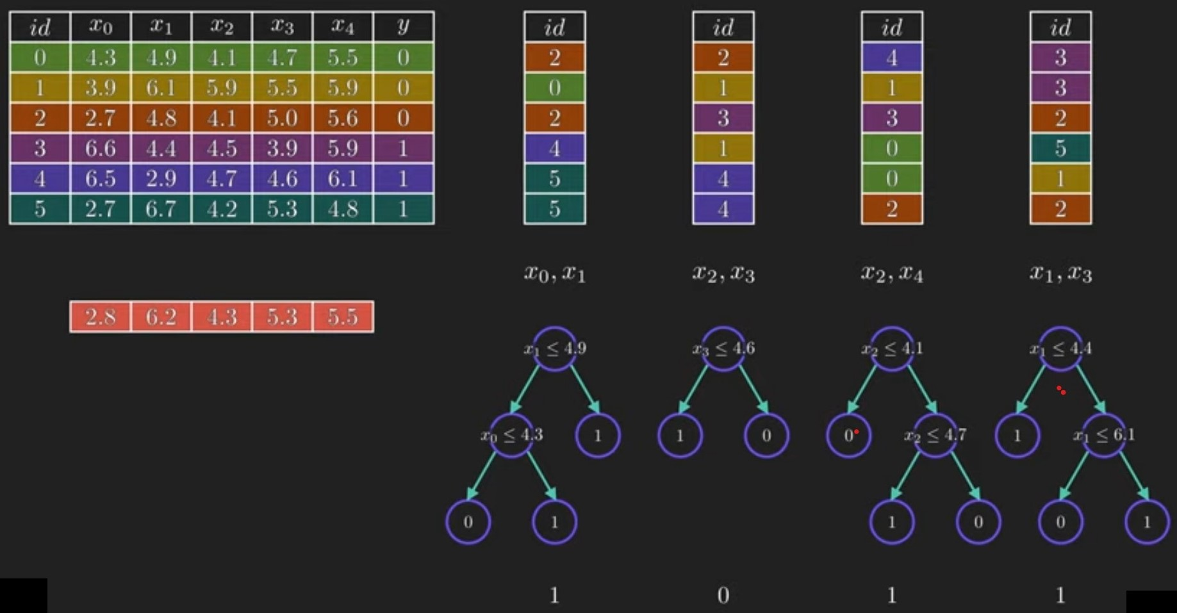
BAGGING = BOOTSTRAPPING + AGGREGATION

Slide 10
ADVANTAGES OF RANDOM FEATURE SELECTION
Reduces correlation between the DTs.
If all use the same set of features, then all DTs might behave similarly.
Results balanced out
Trees trained on less important features will give bad predictions
Some will give bad predictions in the opposite direction.
Number of random features per tree
Sqrt(total features)
log2(Total features)

Slide 11
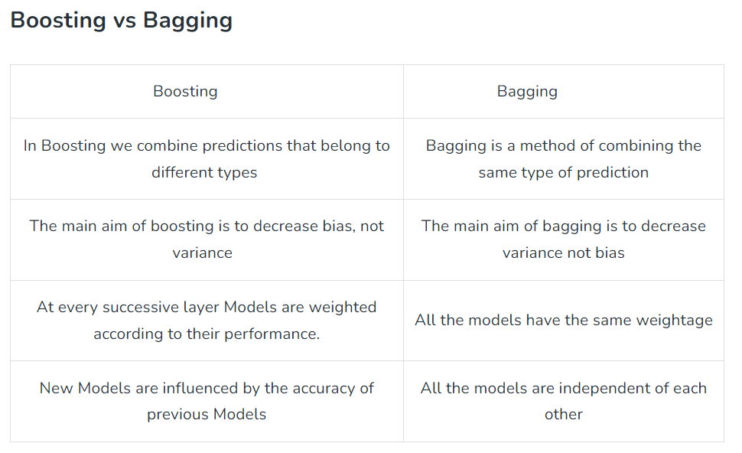
Boosting algorithms: -
The principle behind boosting algorithms is that we first build a model on the training dataset and then build a second model to rectify the errors present in the first model. This procedure is continued until and unless the errors are minimized and the dataset is predicted correctly. Boosting algorithms work in a similar way, it combines multiple models (weak learners) to reach the final output (strong learners).

Slide 12
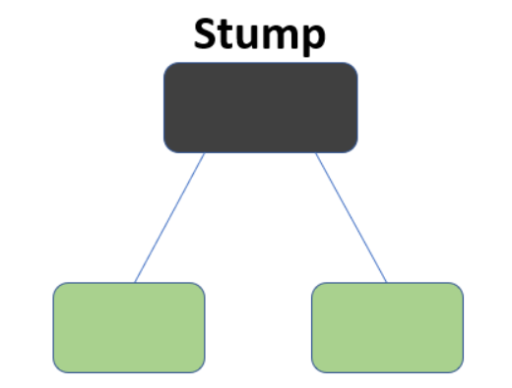
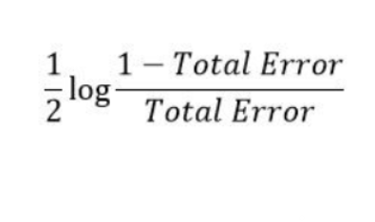
1.) AdaBoost
We first initialize the weight of all samples, assuming its coming from a uniform distribution.
Then we make build a decision tree, in specific a stump after which we would calculate the importance or influence of that particular stump.
After calculating the stump, we would revaluate the sample weights by giving higher importance or weightage to the misclassified samples. The weighted distribution would then be used for making another stump iteratively, and for each stump we would calculate its importance. This is where the algorithm gets its name, Adaptive Boosting as the weights are re-assigned to each instance, with higher weights assigned to incorrectly classified instances.
After training, we do voted ensembling for classification of the stumps, where the importance of each vote is given by the ‘Amount of say’. For regression, we can do a weighted average of all the regression outputs of all stumps.
Amount of say =

Slide 13
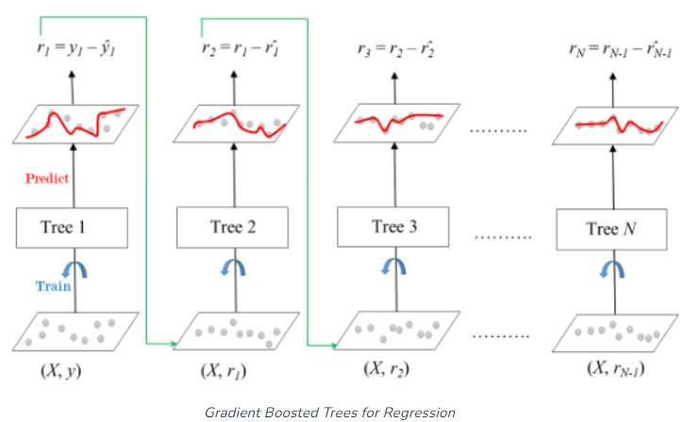
2.) Gradient Boosting: -

Slide 14
Theory: -
In contrast to AdaBoost, the weights of the training instances are not tweaked, instead, each predictor is trained using the residual errors of the predecessor as labels. There is a technique called the Gradient Boosted Trees whose base learner is CART (Classification and Regression Trees). The residual error is the gradient of the loss function, and this is where the name Gradient Boosting comes from.
We restrict the size of the trees usually, as the concept of boosting is to use weak learners to learn a strong one. Theoretically, this concept greatly prevents overfitting and promotes learning higher order representations.
After training, to generate the output, we combine all the trees by using a Shrinkage factor, and the resultant regression value is equal to the sum of the first tree + Shrinkage factor * second tree + Shrinkage factor * third tree … and so on.
For classification, we have to remodel the setup slightly, and we work in the probabilistic domain, and we predict the log likelihood of making a classification by making appropriate transformations in the formulation.

Slide 15
3.) XGBoost: -
It is a specific Implementation of Gradient Boosting, and main principle is the regularizing ability of the trees and this gives this gives the name Extreme Gradient Boosting.
Even here we restrict the size of our trees, but the difference is that, the most common method of decision tree building employed is using XGBoost trees, which differ from traditional trees just by the metric used for splitting a node. Instead of using the gini index for splitting a node, we use the similarity score, which in turn is used to calculate gain or the importance of a node.
There is a hyperparameter lambda, to reduce sensitivity of samples, especially isolated samples and another hyperparameter gamma, which is used to prune trees with nodes with less gain. This is how we are able to regularize the trees.
Other contributions of XGBoost involve handling sparse data, weighted quantile search, support for parallel learning (which is unique cause CART is sequential), cache awareness, out of core computing etc. The last 4 points in specific are important as they drastically decrease the training time.

Slide 16
4.) CatBoost: -
CatBoost is an open-source machine learning(gradient boosting) algorithm, with its name coined from “Category” and “Boosting.” It was developed by Yandex (Russian Google ) in 2017
To understand CatBoost, it is imperative to understand the different types of encoding techniques for categorical data!
A few include:
One hot encoding
Label encoding
Target Encoding
Target Encoding with weighted mean
K-Fold Target Encoding.

Slide 17
CatBoost (contd.)
CatBoost uses ordered target encoding, and this is a way to prevent Data Leakage, which is fatal and our model will learn low level ideas in the case of Leakage. And this feature is called ordered boosting. Classic boosting algorithms are prone to overfitting on small/noisy datasets due to a problem known as prediction shift. When calculating the gradient estimate of a data instance, these algorithms use the same data instances that the model was built with, thus having no chances of experiencing unseen data. Whearas CatBoost, uses ordered boosting, a permutation-driven approach to train model on a subset of data while calculating residuals on another subset, thus preventing target leakage and overfitting.
Native feature support: CatBoost supports all kinds of features be it numeric, categorical, or text and saves time and effort of preprocessing.
Also, there is another hyperparameter Cover, which helps in pruning and regularizing trees. Also the metric to split nodes commonly used in CatBoost is Cosine Similarity.

Slide 18
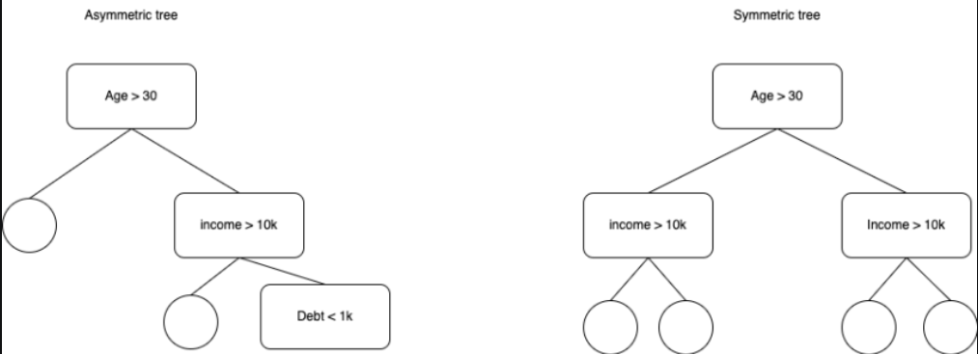
CatBoost (contd.)
Also, CatBoost uses Symmetric trees uses Symmetric trees to speed up computation time and enable parallel computing.

Slide 19
LightGBM: -
Light Gradient Boosting Machine, is a gradient-boosting framework based on decision trees to increase the efficiency of the model and reduces memory usage.
It has 2 main contributions: -
Gradient-based One Side Sampling Technique: - After making the decision tree, it will use the loss function and for each sample it will calculate the steepest gradient samples, which are the samples performing badly in the current model, and will be weighted more heavily in the sampling of the next batch of data fed to the next decision tree.
Exclusive Feature Bundling: This performs feature reduction as in a sparse feature space, many features are mutually exclusive, i.e., they never take nonzero values simultaneously. The exclusive features can be safely bundled into a single feature (called an Exclusive Feature Bundle). For example, if there is feature called isMale and isFemale, they can be bundled into one feature called gender.

Slide 20

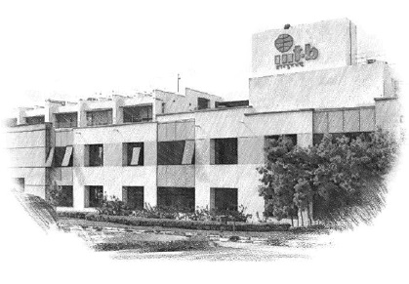


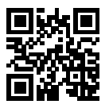



International Institute of Information Technology Bangalore
26/C, Electronics City, Hosur Road,
Bengaluru – 560 100, Karnataka, India
www.iiitb.ac.in
https://www.facebook.com/IIITBofficial/
https://twitter.com/IIITB_official
https://www.linkedin.com/school/iiit-bangalore/
https://www.youtube.com/user/iiitbmedia
https://www.instagram.com/iiitb_official/

